Slide 1

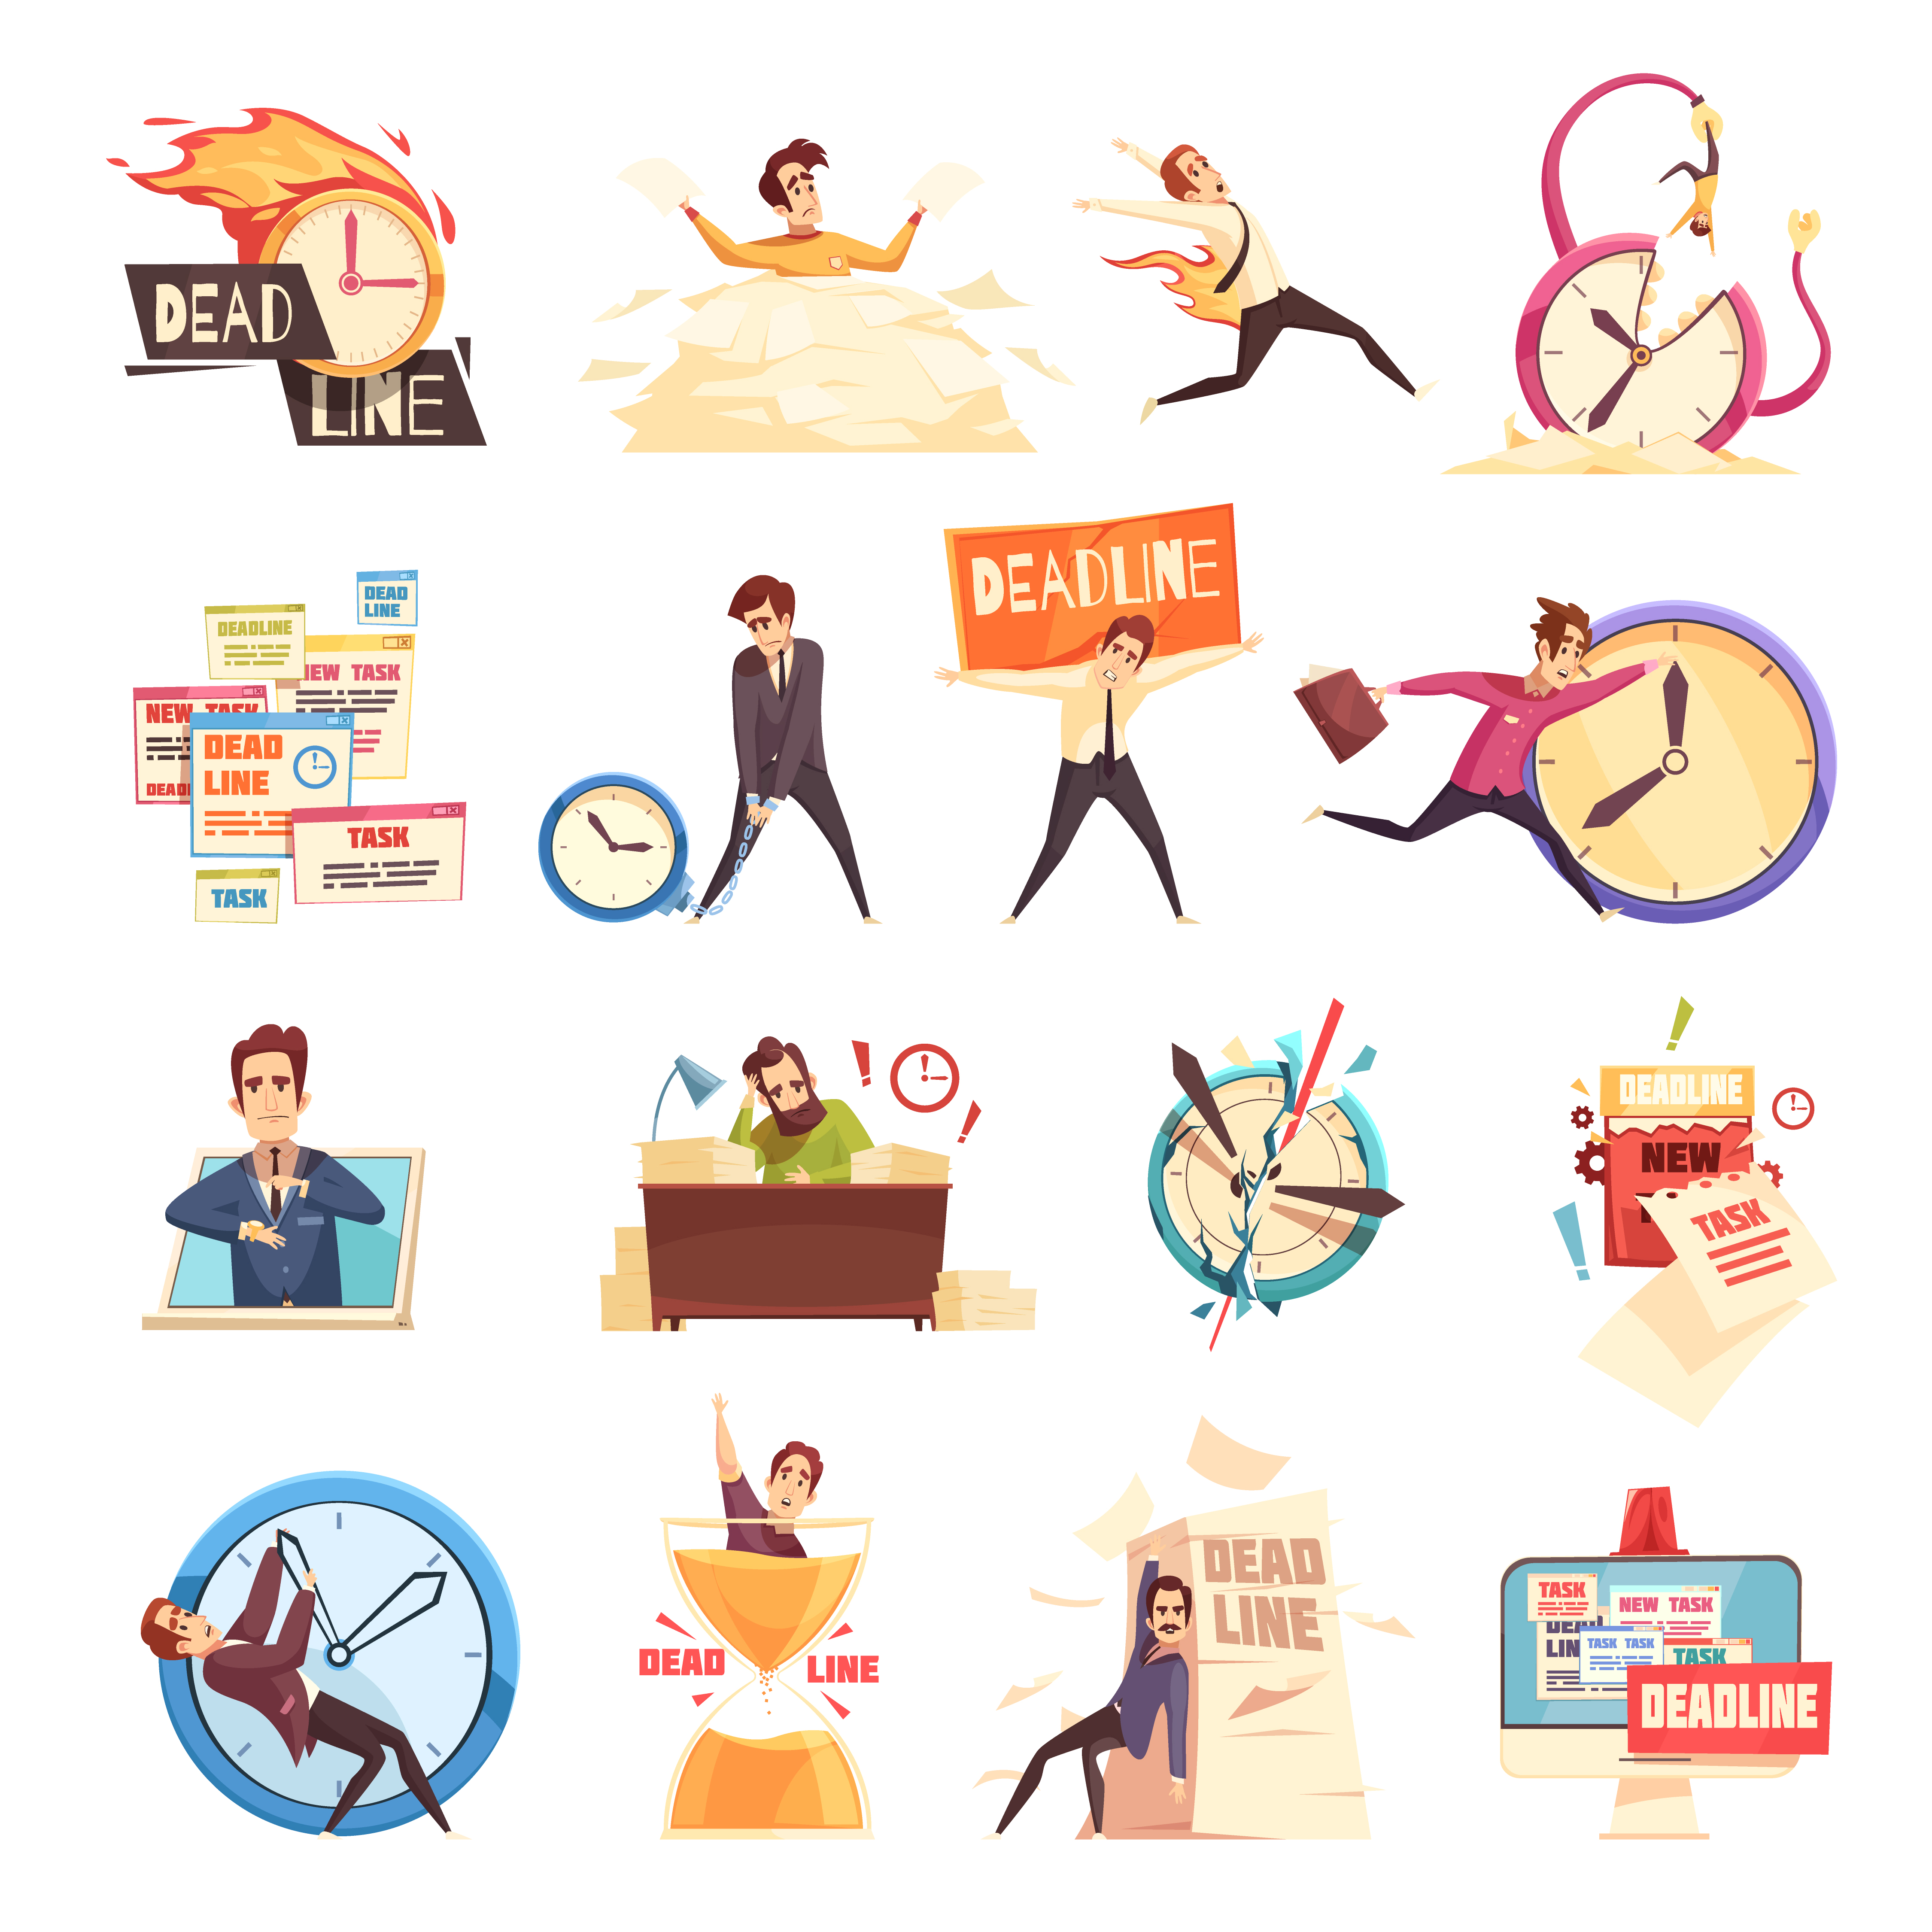
Starter
Why do you think Exam , assessment and Coursework deadlines are such a source of stress for some people?
What top tips do you have for someone who stresses over deadlines?

Slide 2

Dealing with exam stress
Watch the video and each of you need to make a minimum of 2 pledges based on the strategies in the video.
Tutors will ask for feedback from students as to which ones they’ve chosen and why they think they will help you.
https://www.youtube.com/watch?v=VZTGBj7Zyvk

Slide 3

Shared Area Resources:
Shared Area
Wellbeing
The next few slides are going to run through some of the resources available on the shared area to support you.

Slide 4
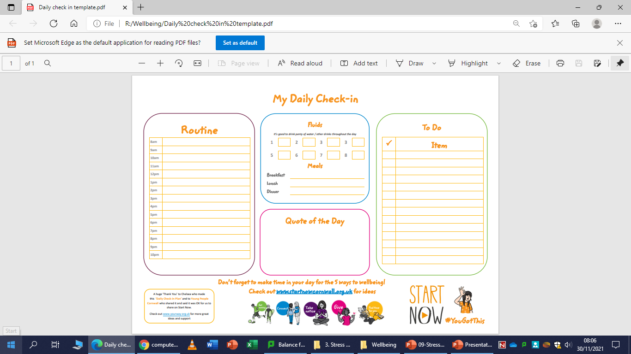
My daily check in – This can be used to structure your day while you are off. Having a do list that you can tick off can help manage anxiety.

Slide 5
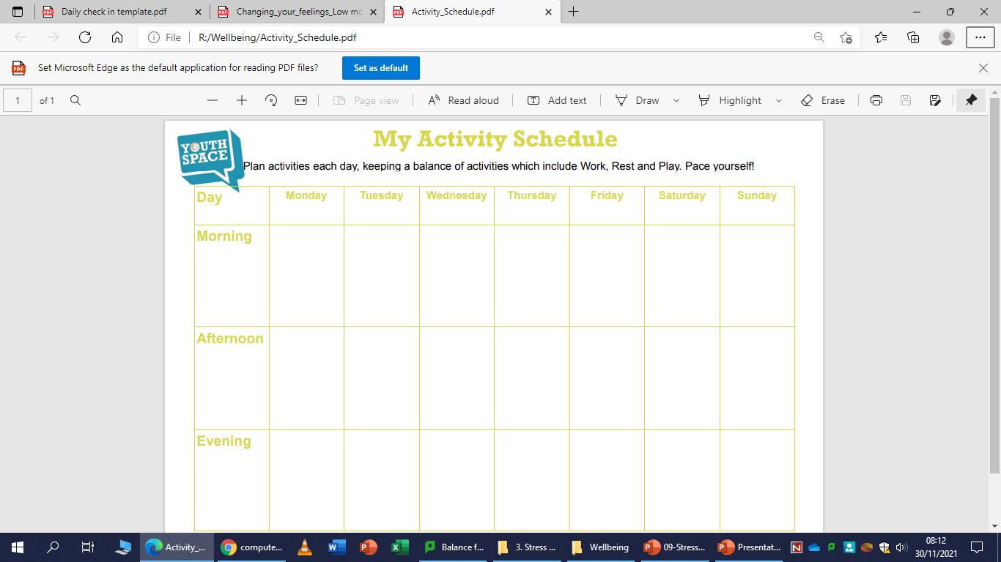
My activity schedule – Similar to the previous slide, the activity schedule allows you to add a medium term perspective to your planning. What do you need to achieve this week, where can you add in time for yourself, your friends and your family? Remember, to manage stress and anxiety around exams, you need to have a balance.

Slide 6
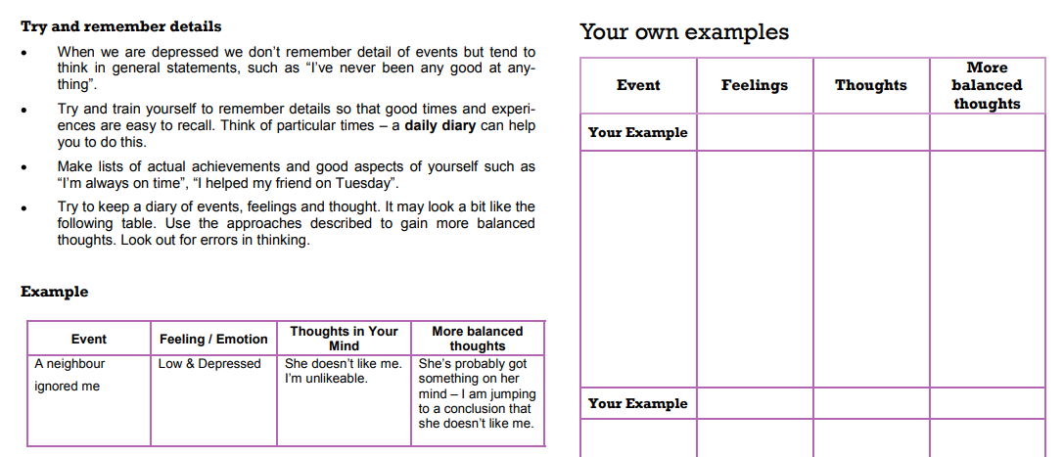
Changing your low mood – I think at times everyone is guilty of irrational thoughts. Tracking events that cause low mood and rationalising them in writing helps you process them in a more logical way, leave them behind and move on with your day.

Slide 7
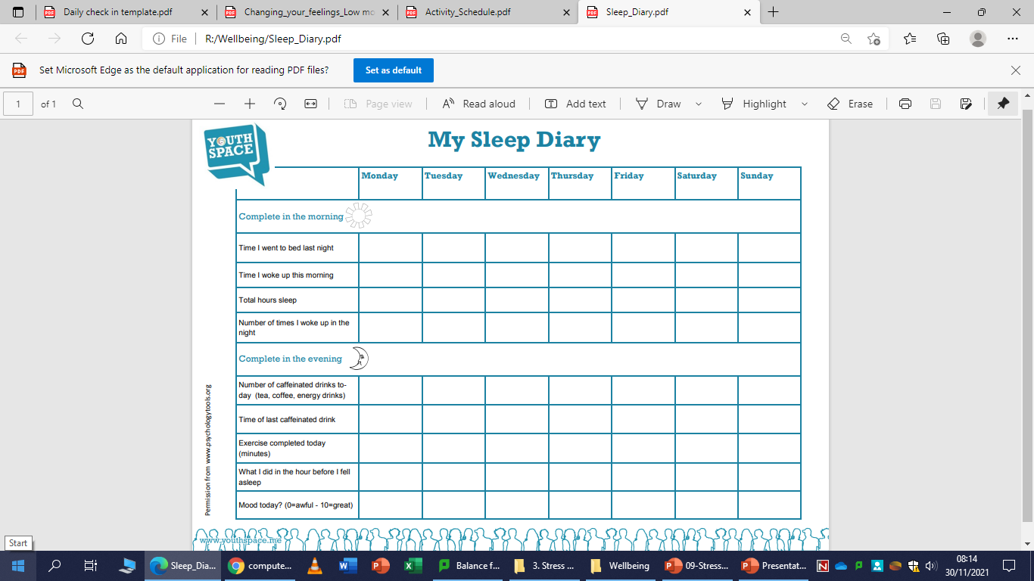
My sleep diary– One of the biggest triggers for stress and anxiety is poor sleep routine. This diary gives you a chance to log your evening activity and reflect on how that impacted your sleep. To often, to many young people are sat on laptops / phones until all hours and fail to draw the link between that and how they feel the day after.

Slide 8
These resources are all available for you to save on your user area or print off in the LRC and take home.
Please access them to support yourself in maintaining / improving your wellbeing.
What is next…
Building on todays session, on Monday, Northumbria University will be coming in to deliver a session on ‘Effective Revision’ to help you prepare for your mock exams.
This session was organised for you off the back of lots of ‘I don’t know how to revise’ during mentoring. So if you want to bring a pad and paper to make notes then please do.

