Slide 1
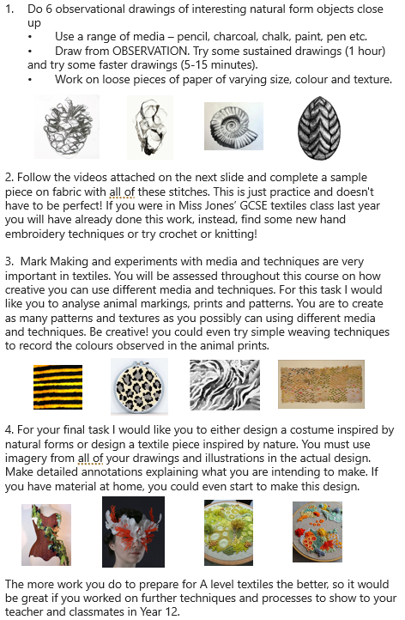

Slide 2
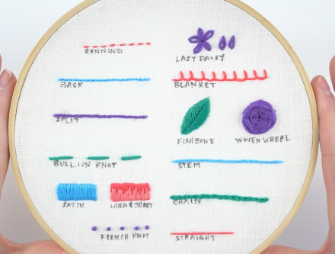
Videos
Running stitch - How to quick video tutorial - hand embroidery stitches for beginners – YouTube
Backstitch - How to quick video tutorial - hand embroidery stitches for beginners – YouTube
Split stitch - How to quick video tutorial - hand embroidery stitches for beginners – YouTube
Stem stitch - How to quick video tutorial - hand embroidery stitches for beginners – YouTube
Blanket Stitch - How to quick video tutorial - hand embroidery stitches for beginners – YouTube
Chain stitch - How to quick video tutorial - hand embroidery stitches for beginners – YouTube
Satin stitch - How to quick video tutorial - hand embroidery stitches for beginners – YouTube
Long and Short Stitch - How to quick video tutorial - hand embroidery stitches for beginners
Seed Stitch - How to quick video tutorial - hand embroidery stitches for beginners – YouTube
fly stitch embroidery tutorial – YouTube
Lazy Daisy Stitch - How to quick video tutorial - hand embroidery stitches for beginners – YouTube
Embroider Leaves with the Fishbone Stitch – YouTube
How to do a Woven Wheel Stitch – YouTube
French knot

